Slide 1
CIS 434 - Lab
Class 2

Slide 2
Today’s material:
Overfitting problems
Sentiment analysis methods

Slide 3
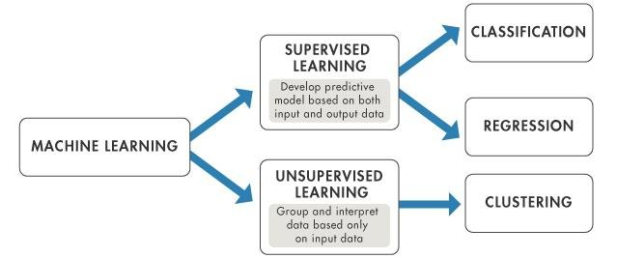
Machine Learning Framework
https://www.researchgate.net/figure/Supervised-Learning-versus-Unsupervised-Learning-Mathworks-nd_fig1_319937079

Slide 4
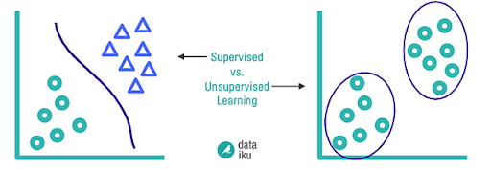
Supervised vs unsupervised learning:

Slide 5
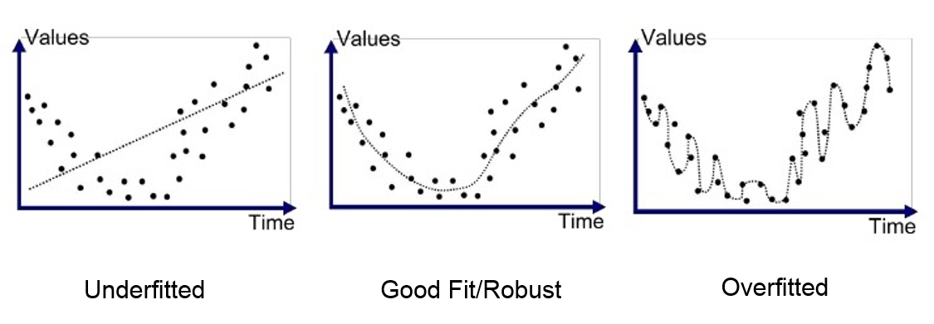
Overfitting problems:

Slide 6
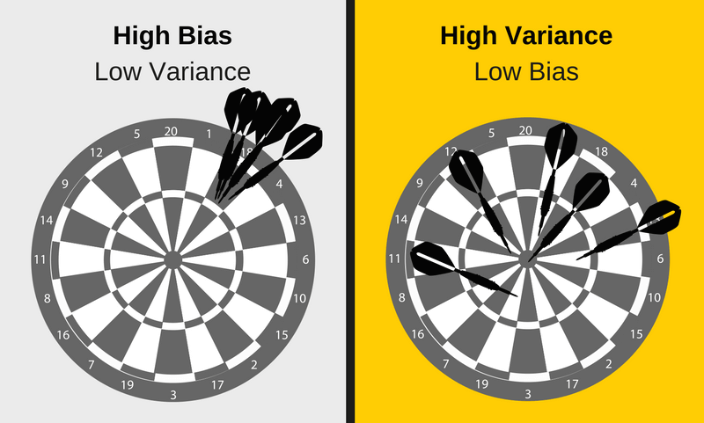
Bias Variance Trade-off

Slide 7
Cross Validation
More data
Too many features? remove them
Regularization
More.

